Slide 1
Relations vs. Functions Function Notation, & Evaluation
Lesson 5-1

Slide 2
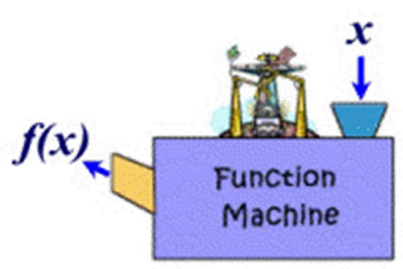
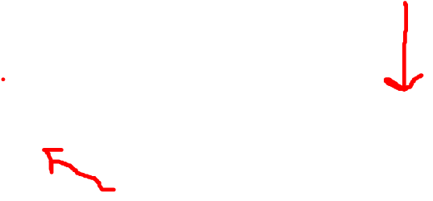
What is a function?
A function is a defined rule (or formula) that assigns one and only one output (usually f(x)) for each input (usually x).
It is like a machine that takes in an input (x) to produce an output f(x)

Slide 3
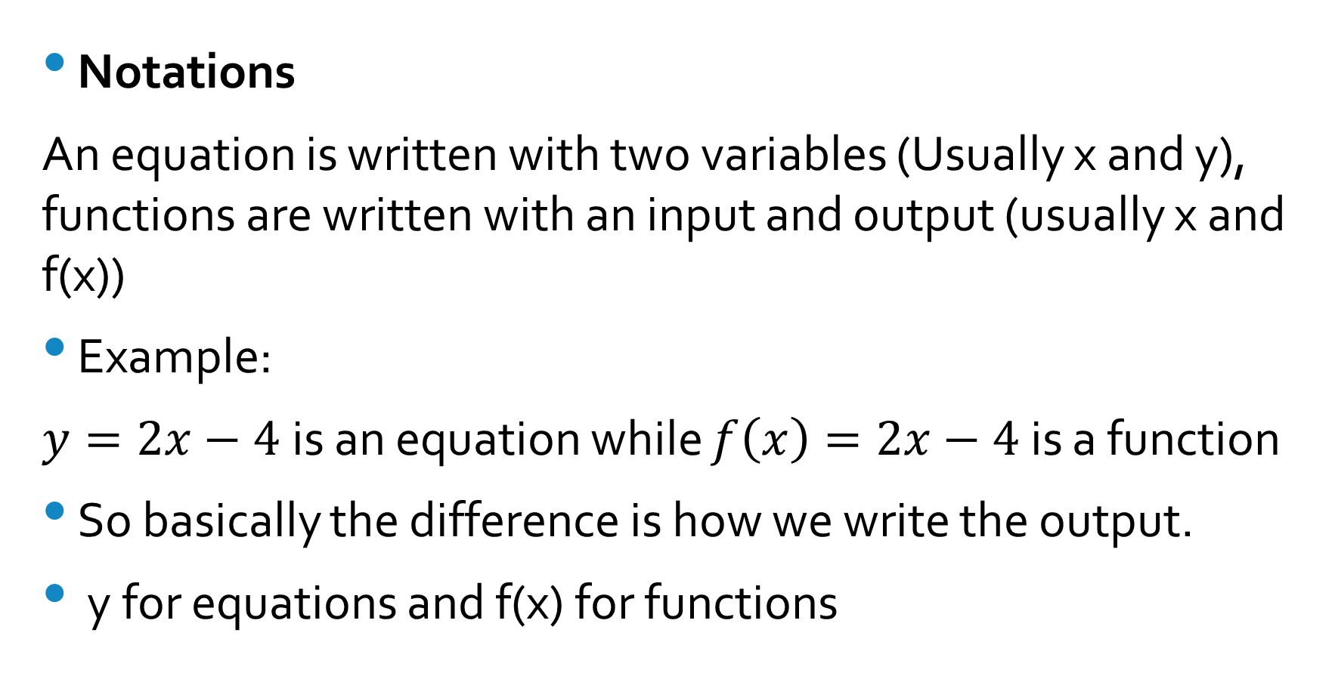
What is the difference between functions and equations in two variables?
Notations
An equation is written with two variables (Usually x and y), functions are written with an input and output (usually x and f(x))
Example:
$y=2x−4$is an equation while $f\left(x\right)=2x−4$ is a function
So basically the difference is how we write the output.
y for equations and f(x) for functions

Slide 4
What is the difference between functions and equations in two variables?
Solutions and Outputs
An equation can have more than one solution , or more than one value for y
A function does not have two or more outputs for one input. It has one and only one output for each input
If a defined rule has more than one output for an input its called a relation.

Slide 5
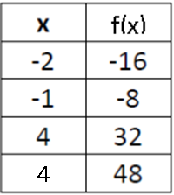
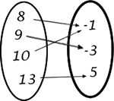
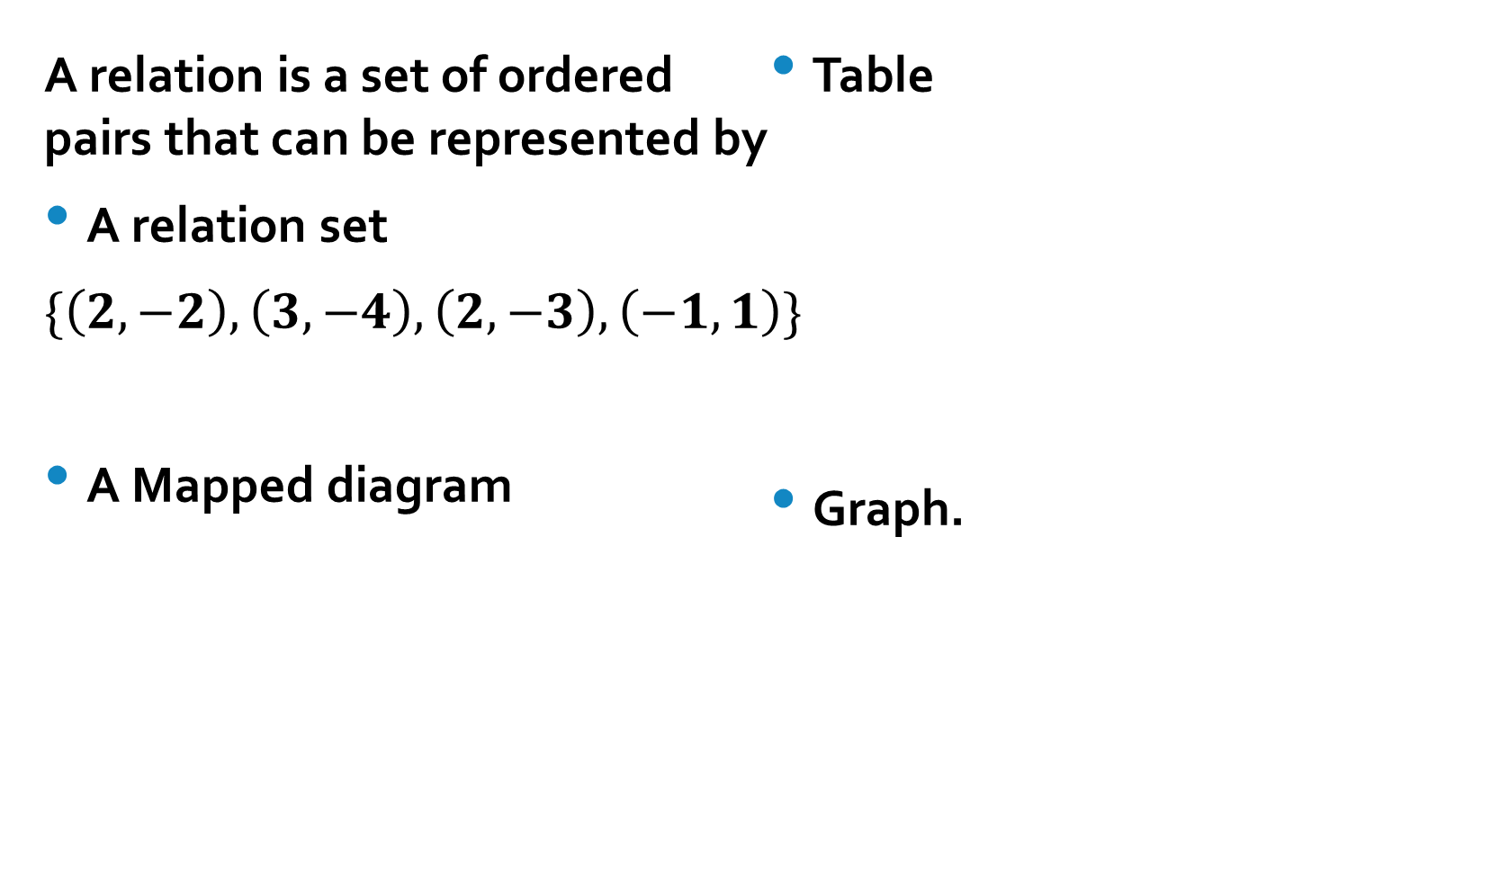

What is a relation?
When each input has one and only one output the relation is called a function
A relation is a set of ordered pairs that can be represented by
A relation set
$\{\left(2,−2\right),\left(3, −4\right),\left(2,−3\right), \left(−1,1\right)\}$
A Mapped diagram
Table
Graph.

Slide 6
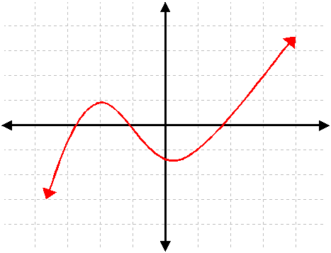
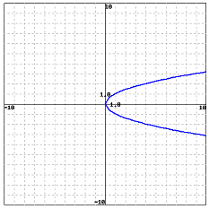
Vertical line Test (VLT)
How do we know if a relation represented graphically is a function?
Not a function
A function

Slide 7
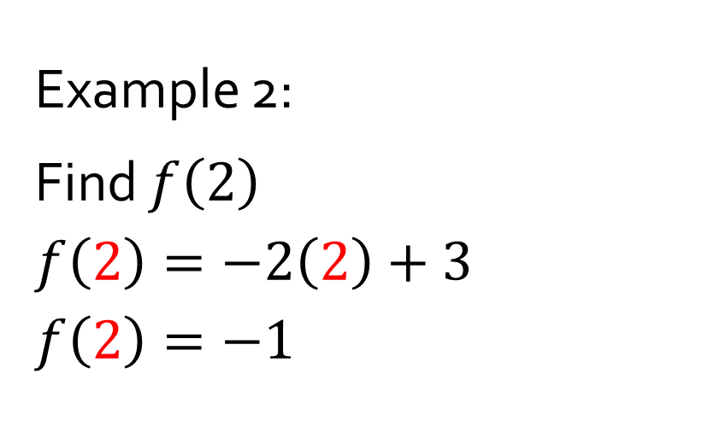
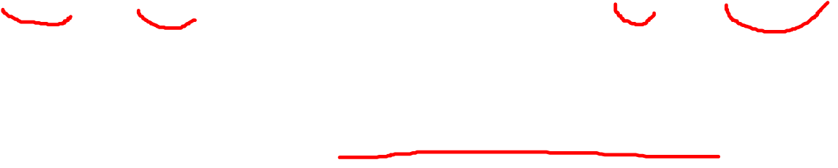
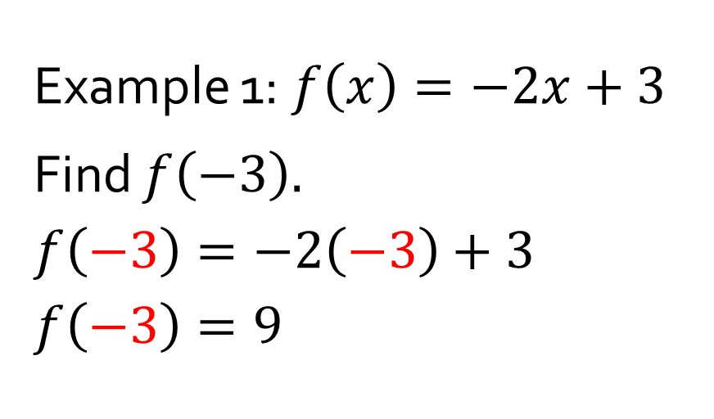
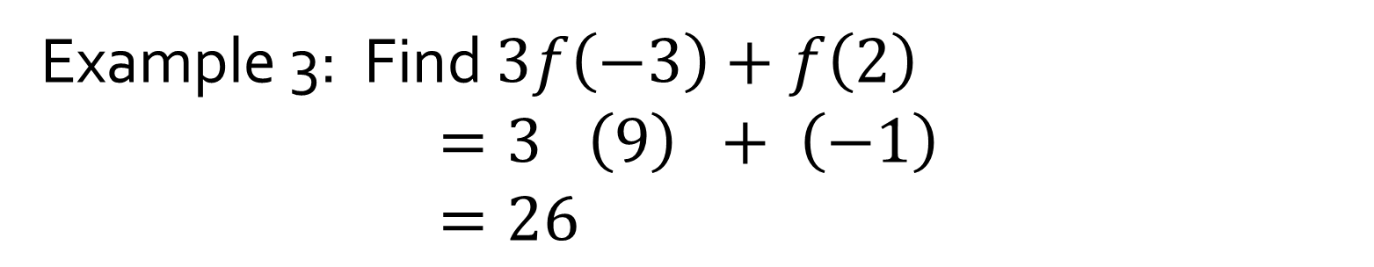
Evaluation of a Function:
Example 1:$f\left(x\right)=−2x+3$
Find $f\left(−3\right).$
$$f\left(−3\right)=−2\left(−3\right)+3$$
$$f\left(−3\right)=9$$
Example 2:
Find $f\left(2\right)$
$$f\left(2\right)=−2\left(2\right)+3$$
$$f\left(2\right)=−1$$
Example 3: Find $3f\left(−3\right)+f\left(2\right)$
$=3 \left(9\right) + \left(−1\right)$
$=26$

